Slide 1
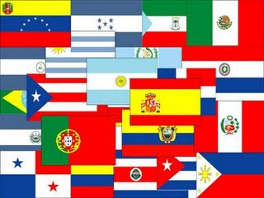

Spanish - Español - Castellano
Amit Abbi
Srilekha VK

Slide 2

Romance Language
One of the most phonetic languages
Indo-European Family of Languages
One of the 6 official languages of UN
Royal Spanish Academy (Real Academia Española) - arbiter of what is considered standard Spanish

Slide 3

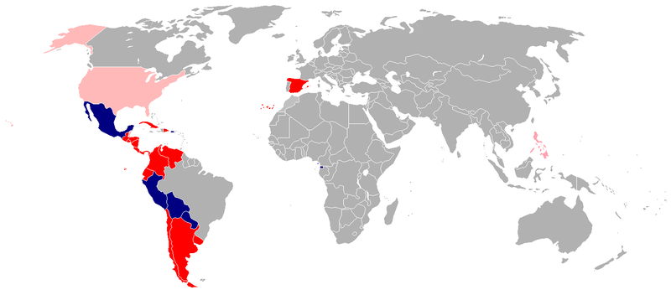
Second most spoken language
Sole official Language
Number of Speakers
L1: 328 M
L2: 60 M
Co-official Language
Significant Language (Not official)
Notes:
Official language of 22 countries, second most natively spoken, fourth most geographically widely spoken (44 countries)

Slide 4
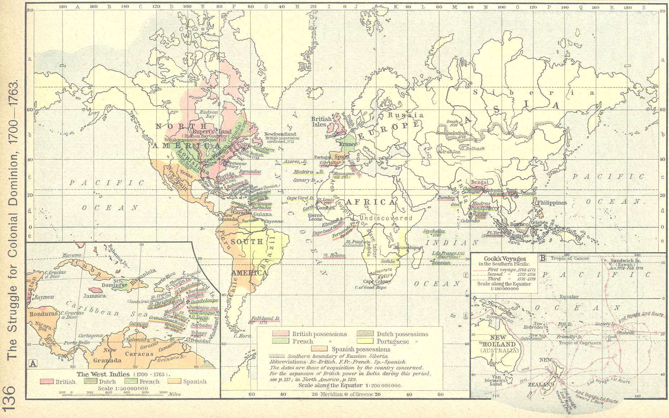

Vulgar Latin
Arabic
Spanish
Visigothic
Basque/Celtiberian

Slide 5

azúcar: sugar. From Arabic (سكر) sukkar of the same meaning.
alfaguara: Geyser. From Arabic fawwâra (فوارة): spout, fountain, jet d'eau
algoritmo, algorithm, that comes from the name of Muhammad ibn Musa al-Khwarizmi, محمد بن موسى الخوارزمي, famous mathematician.

Slide 6

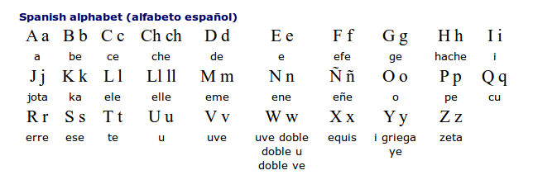
For vowels, acute accent and diaeresis marks are used
Capitalization in Spanish is sparse compared to English
Inverted q-marks and exclamation marks
Notes:
Names of nationalities or languages, religions, calendars, ordinal numbers, place identifiers(like geographic features) are not capitalized
The vowels can be marked with an accute accent to mark stress if it does not follow the normal pattern, or to differentiate otherwise equally spelled words (this is the true diacritic usage).
There are three additional letters - che (<ch>), elle (‹ll›) and eñe (‹ñ›).
three digraphs: ‹ch› (che), ‹ll> (elle / doble ele) and ‹rr> (doble erre).[

Slide 7
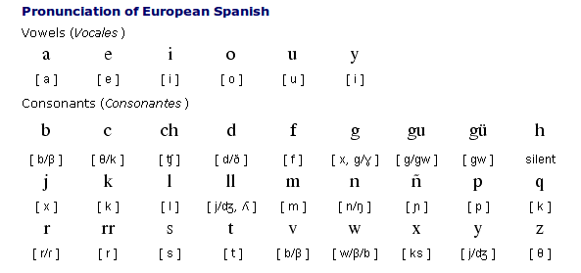
Phonemic
Consistent mapping of grapheme to phoneme.
Syllable-Timed language
Stress generally on one last three letters
Notes:
Syllable Timed - Each syllable has same duration regardless of stress.

Slide 8

Ll
  /ʎ/ Casillas
  /ʝ/ ballena
RR
  /rr/ burro
ñ
  /ɲ/ - Español
Intonation in Spanish
¿Cómo "¿cómo como?"? ¡Como como como!
(What do you mean, how do I eat? I eat the way I eat!).

Slide 9

Peninsular Spanish
  Castilian – Northern Spain
  Andalusian – Southern Spain
Neutral Spanish
Spanish of the Americas
  Latin American Spanish – all dialects throughout most of Latin America, loan words from English
  Caribbean Spanish
Notes:
A number of different dialects
Dialects written standard is same, but vocab may differ
Peninsular spanish – european spanish
Neutral spanish - avoid colloquialisms and potentially offensive language, verb tenses that have disappeared from other varieties of Spanish, also known as Global Spanish or Universal Spanish
Casitilian Spanish may refer to standard spanish

Slide 10

Moderately Inflected Language
Pro-drop language
Two-gender system
  Masculine
    nominal suffix ‘o’
    Determiner ‘el’
  Feminine
    Nominal suffix ‘a’
    Determiner ‘la’

Slide 11
Nominal Inflection – gender, number
  Somos hermanas." (We are sisters.)
    herman - a – s
    herman - This conveys the quality of being siblings.
    *a – gender(feminine)
    *s – number(plural)
Verbal-Nominal Inflections - infinitive ending –ar/-er-/-ir, gerund –ando/-endo, past participle –do
  "Tengo ganas de comer." (I feel like eating.)
  come – r
  *come - This conveys the meaning of "eating.“
  *r - infinitive form of the verb

Slide 12

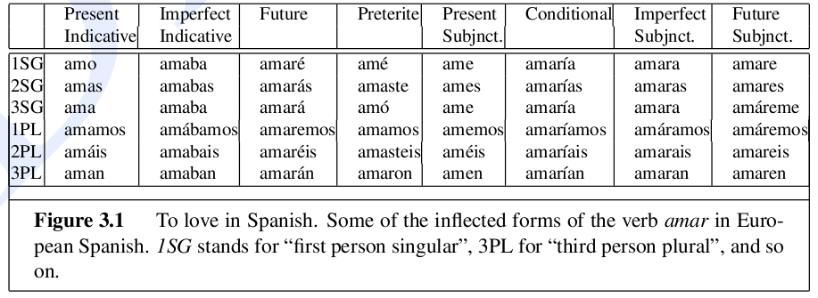
Verbal inflection - About fifty conjugated forms per verb (eg. amar)
Verbs could be inflected in Gender, Number, Tense, Mood
Source: Jurafsky & Martin

Slide 13

Spanish – right branching – places dependents after headwords (except numeral modifiers)
  Mary did not slap the green witch
  Maria no dió una botefada a la bruja verde
  (Mary) (did not) (slap) (the) (witch) (green)
Tokenization in numerals:
  12.345,67 ⬄ 12,345.67
Hyphens are used to indicate quotes
Additional punctuation
Spanish as target language: dialect to be taken under consideration
Notes:
9

Slide 14

Basque, Catalan, English, French, Galician, German, Greek, Italian, Portugese, Quechua, UNL(universal networking language)
Corpora:
  Monolingual:
    Spanish FrameNet (300M words)
    Corpus del espanol (100M words), ARIES Natural Language Tools, Spanish Treebanks
    Spanish Gigaword
  Parallel corpus
    UN Parallel Text
    EuroParl Corpus
Resources:
  European Languages Resources Association
  Linguistic Data Consortium

Slide 15

Notes:
ELRA monolingual corpus, lexicons with morphological information, bilingual lexicons in various fields, speech database.
Europarl - 11 European languages
Corpus de Espanol – corpus collected using spanish texts written in 1200s to 1900s
ARIES - large Spanish lexicon, lexical maintenance and access tools and morphological analyser/generator.

